Slide 1

Online Food Delivery Website
Task - 1

Slide 2



Online Food Delivery Website
It is a online food delivery platform that connects hungry customers with a wide variety of restaurants and cuisines .
It is a user-friendly website ensuring seamless and satisfying experience for both users and restaurant partners.
LMS Username | Name | Batch
au910020104002 | ABINAYA P | CC2
au910020104004 | AKSHAYA S | CC2
au910020104015 | JAYAPRIYA S | CC2
au910020104038 | SANJAY N | CC2

Slide 3
Task - 1
Creation of SRS & Github
Create SRS : “Your Project”
Creation & Set-up of Github account
Creation & Hands-on to various commands of Git Bash
Evaluation Metric:
100% Completion of the above tasks
Learning Outcome
Get to know about different lifecycle models.
Understanding importance and how to create an SRS
Knowing various commands of Github
Understanding agile and scrum management techniques for efficient product development

Slide 4
Step-Wise Description
Identify your target audience and understand their needs.
Analyze the local food delivery market.
Select a reliable web hosting provider.
Write HTML, CSS, and JavaScript code to build the user interface.
Implement features like user registration, login, and search functionality.
Choose a programming language and framework for your server.
Create a database to store user information, restaurant data, and orders.
Implement an order management system.
Integrate payment gateways like PayPal, Stripe, or others.
Set up a customer support system to address user and restaurant inquiries and issues.
Test the usability and functionality of the website.
Deploy the website on your chosen hosting server.
Summary of your task
Creating a food delivery website is a multi-step project that involves careful planning and execution. It begins with idea conceptualization and market research, followed by domain/hosting setup. The website design, front-end, and back-end development stages bring the user interface to life, along with registration, authentication, restaurant management, order processing, payment integration features. Quality assurance and testing ensure a bug-free website, and the launch is followed by a marketing strategy to attract users and restaurants. Ongoing customer support, feedback collection, and iteration are vital for success. Building a food delivery website demands a comprehensive approach and a commitment to meeting user needs and market demands.

Slide 5



Assessment Parameter
Gather requirements for the project
add Readme.md file with description of the project
Prepare database design schemas
Check-List
Commit all changes with "first commit"
Get your initial project Structure ready
create a repository on github related to project
Initiate a git repository
Push your changes to github

Slide 6
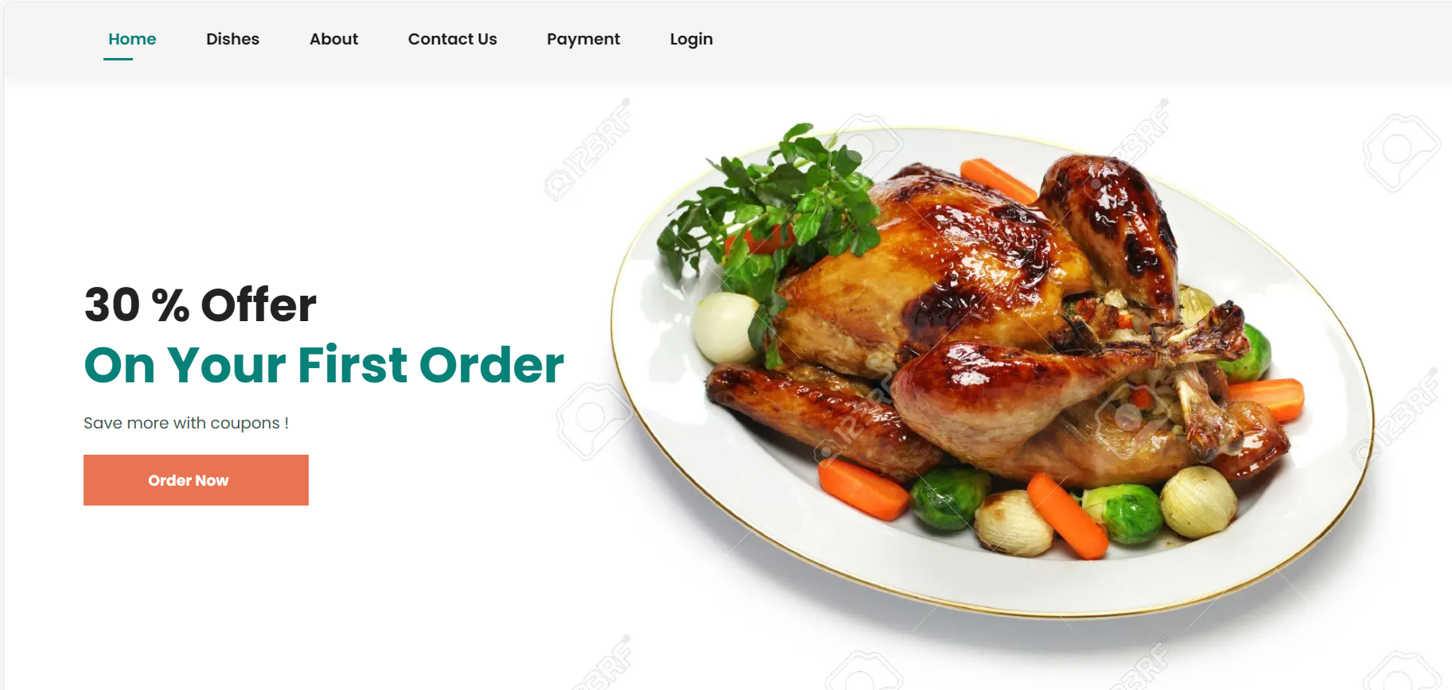
USER INTERFACE
HOME PAGE

Slide 7
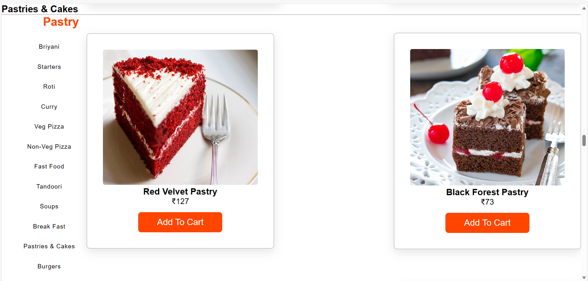
FOOD ORDERING PAGE

Slide 8
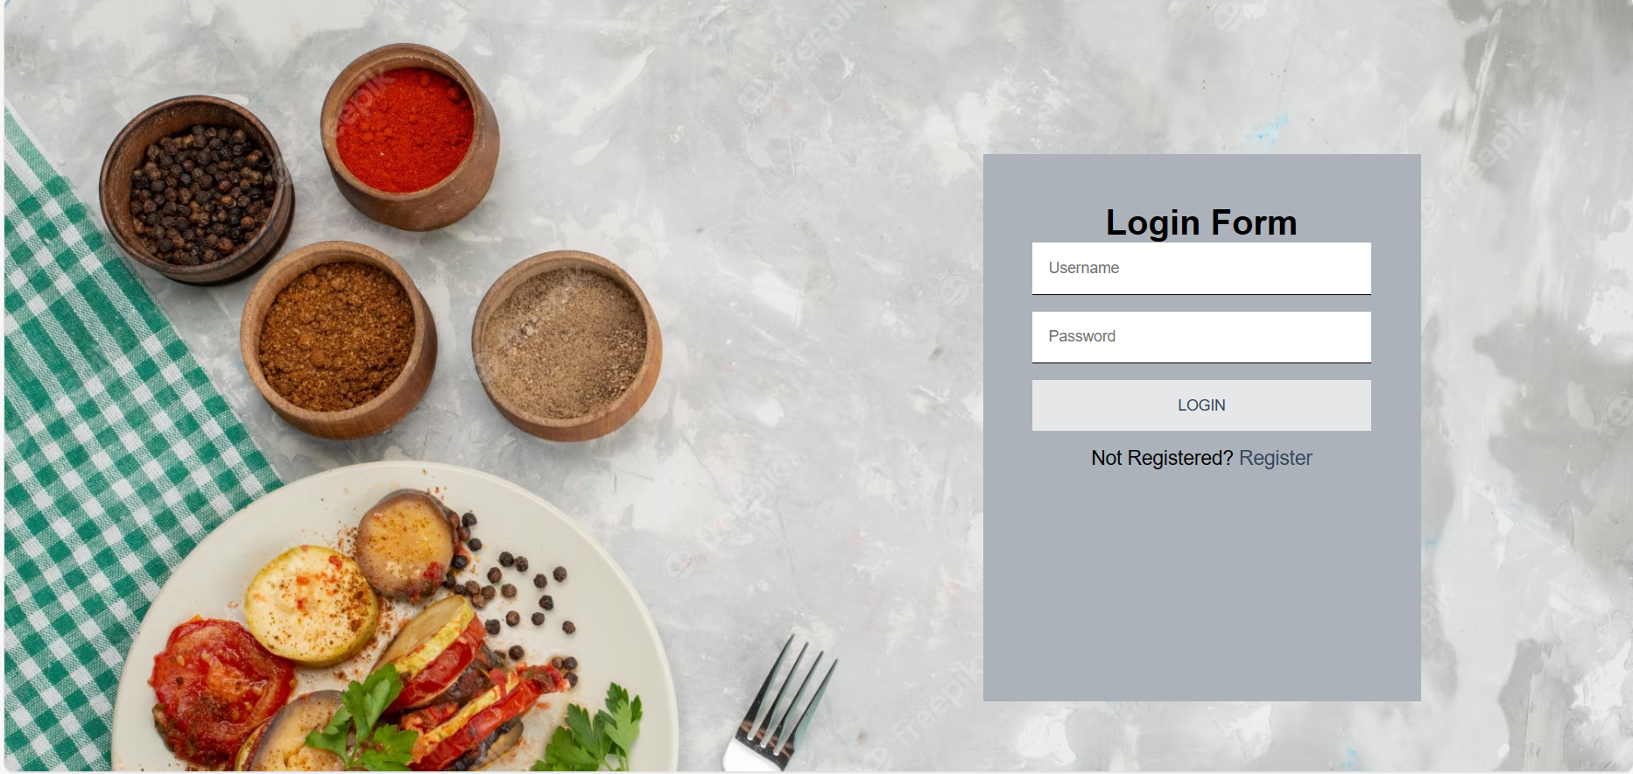
LOGIN / REGISTRATION PAGE

Slide 9
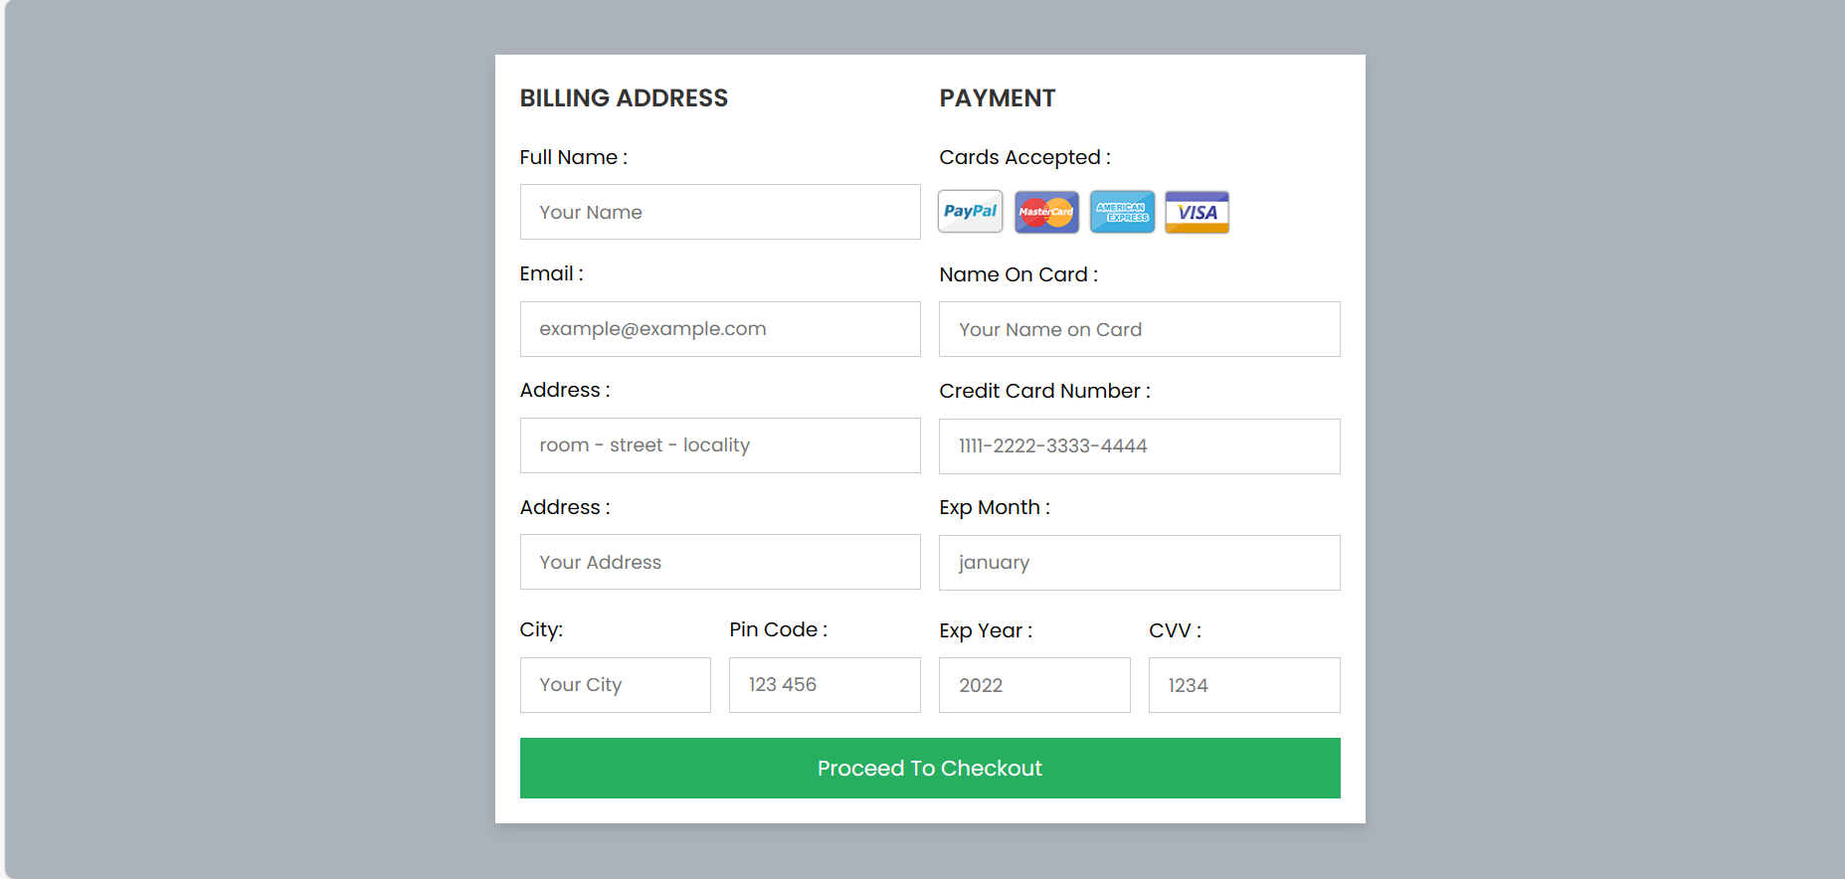
PAYMENT PAGE

Slide 10


Submission Github
https://github.com/Jayapriya34/Online_Food_Delivery_Project

Slide 11


